Slide 1
Umeed
Problem Statement 28
A Domestic Violence Support System
Develop a secure and anonymous mobile app or Web app designed to support individuals experiencing domestic violence. The application includes features such as anonymous user profiles, a comprehensive resource database with legal, medical, and counseling information, a secure and private messaging system, emergency alert functionality with location tracking, and the ability for users to create safety plans tailored to their specific situations.
Team Number: 15

Slide 2
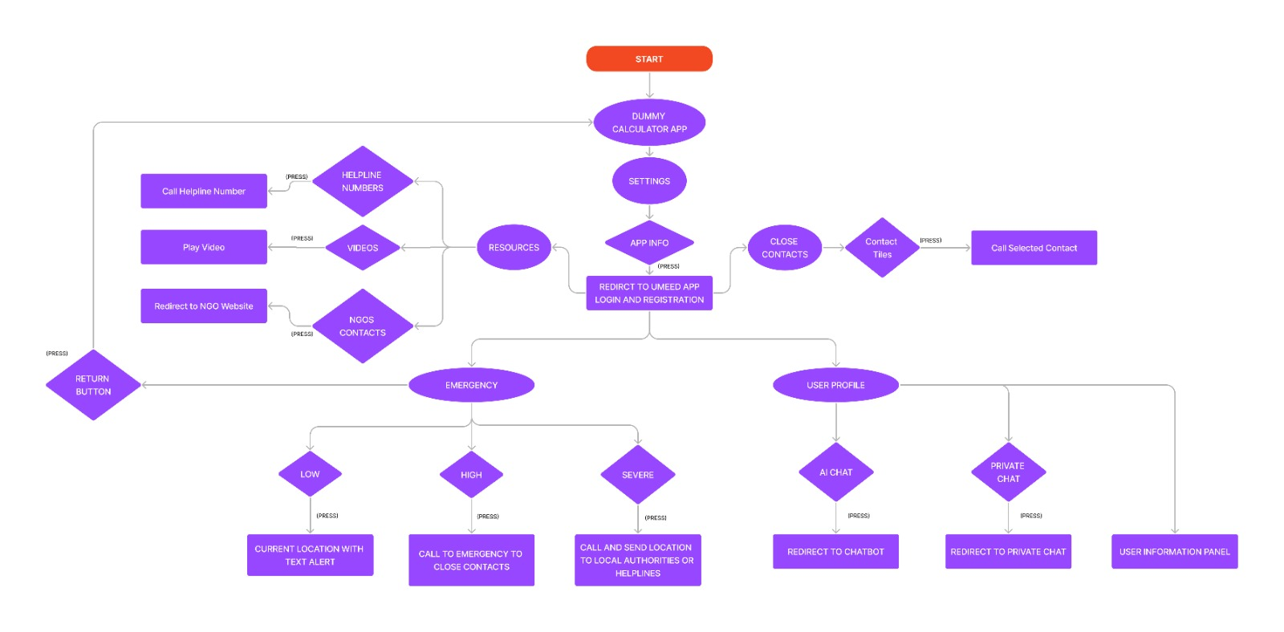
(TECHNOLOGIES USED)

Slide 3
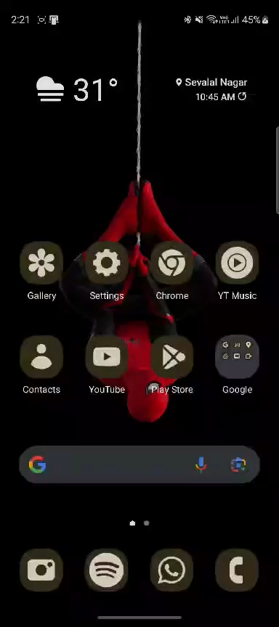
SITMULATION

Slide 4
UNIQUENESS
Anonymous mobile app also includes features such as anonymous user profiles
PRIVATE AI CHAT FOR INSTANT HELP
EMERGENCY ALRETS AND CALLS
LOCATION SHARING
A comprehensive resource database with legal, medical, and counseling information

Slide 5
FUTURE SCOPE
ALLOWING GOVERNMENT ORGANZATIONS TO REGISTER ON THE APPLICATION TO PROVIDE IMMEDIATE SUPPORT
CONNECTING VICTIMS TO HEALTHCARE PROFFESIONALS LIKE MENTAL HEALTH COUNCELORS.
INTEGRATE CHATBOT INTO THE APPLICATION
CREATING A BUSINESS MODEL TO GENERATE REVENUE TO HELP VICTIMS

